Slide 1


BASIC DETAILS OF THE TEAM
AND PROBLEM STATEMENT
Ministry/Organization Name/Student Innovation: Policy Planning Cell, Ministry of Information & Broadcasting.
PS Code: NS1226
Problem Statement Title: Dashboard for real time indication of the online media and social media activities of the media units. Such a Dashboard may provide Quantitative Information such as Real-time Statistical Summaries in terms of Engagements , post , etc. on Social Media ; and Qualitative Information such as the range of key topics on which information is disseminated.
Team Name: MYKRO INFINITY X
Team Leader Name: PRAABINDH P
AISHE Code: C-16537
Institute Name: St. Joseph's College of Engineering
Theme Name: Smart Automation

Slide 2
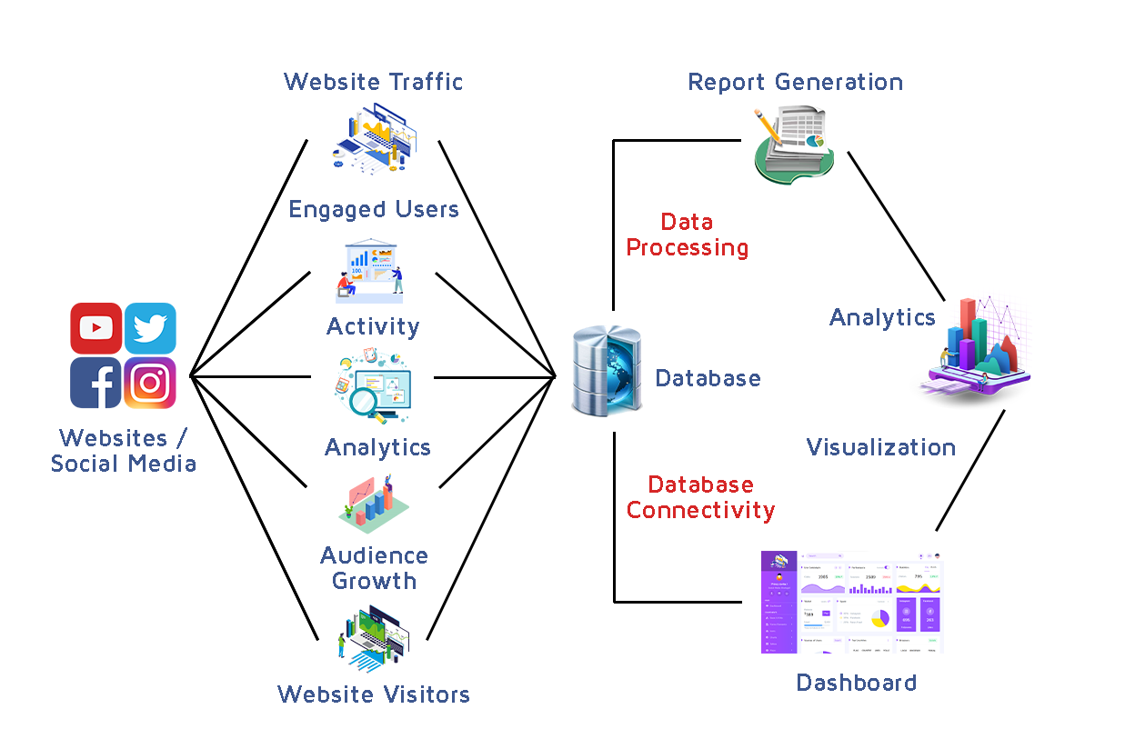
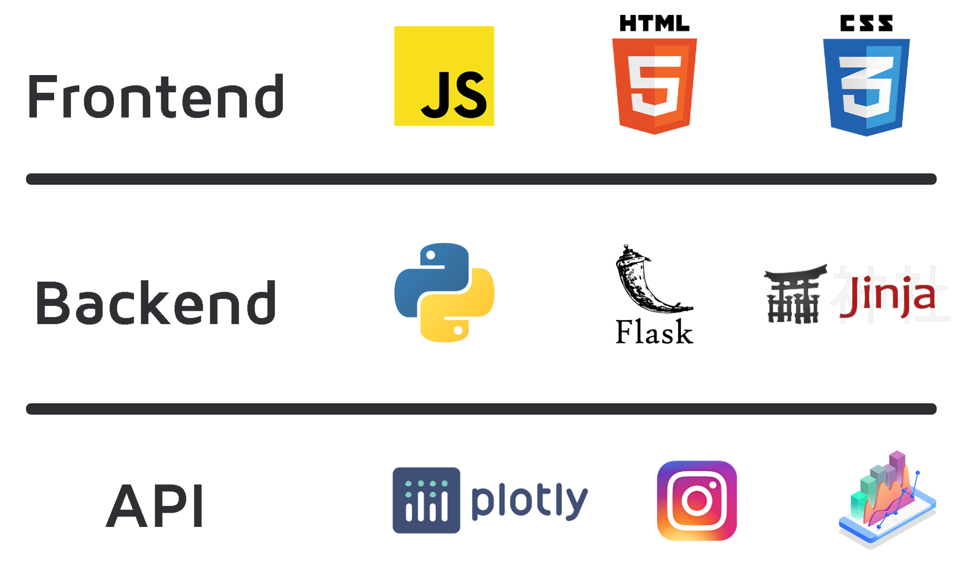
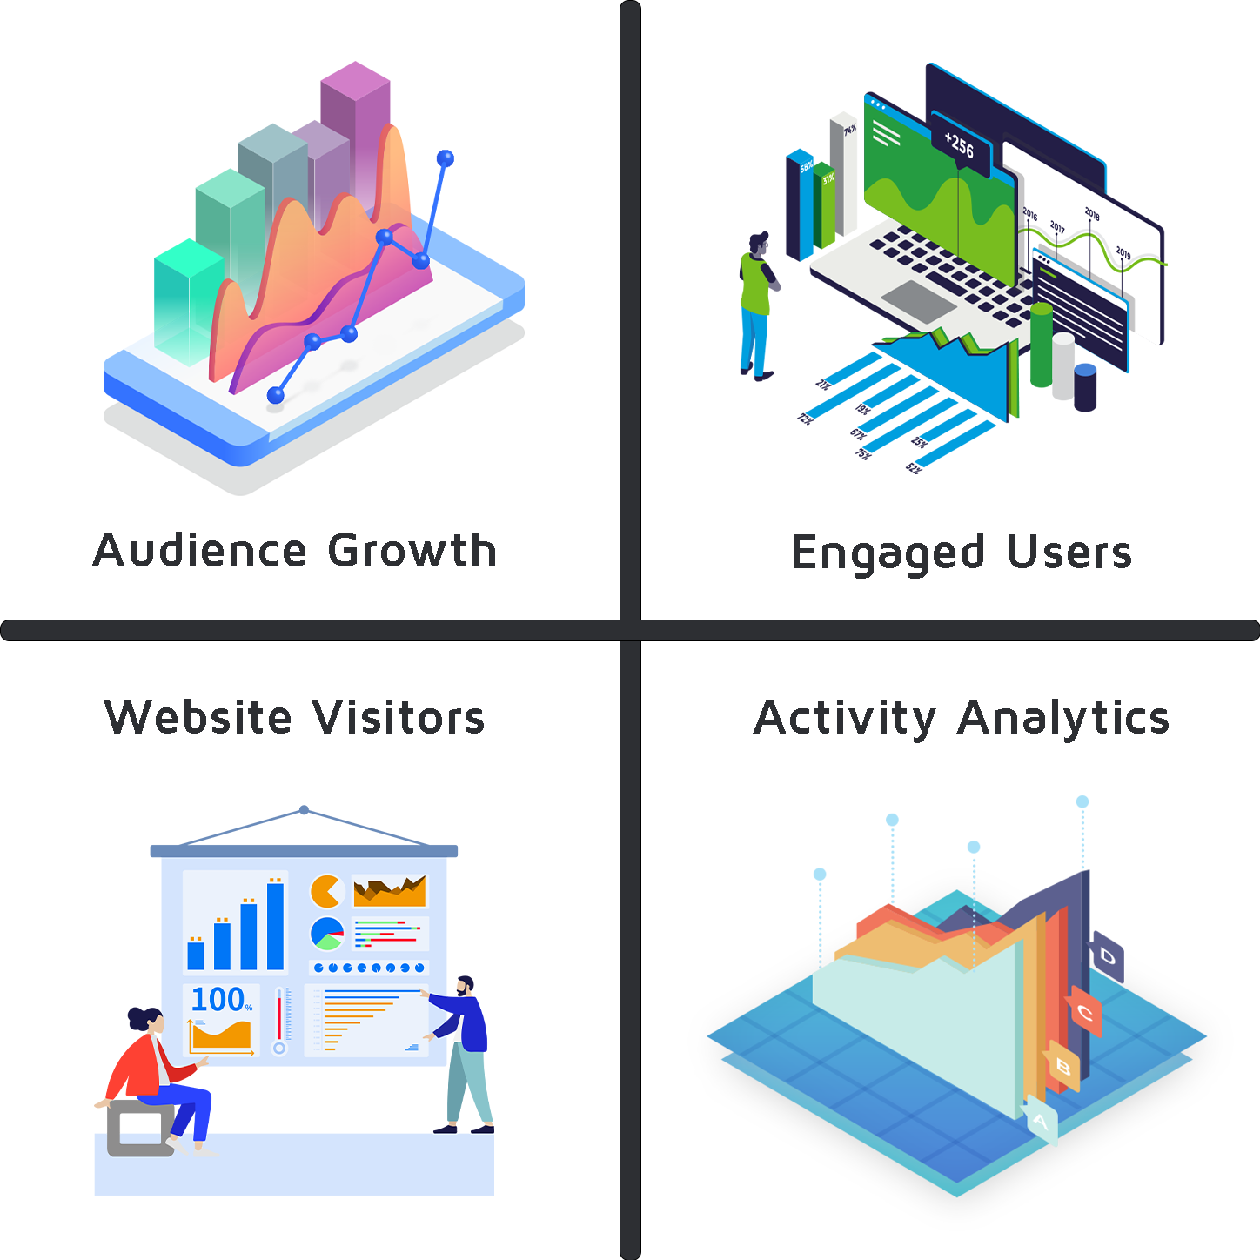
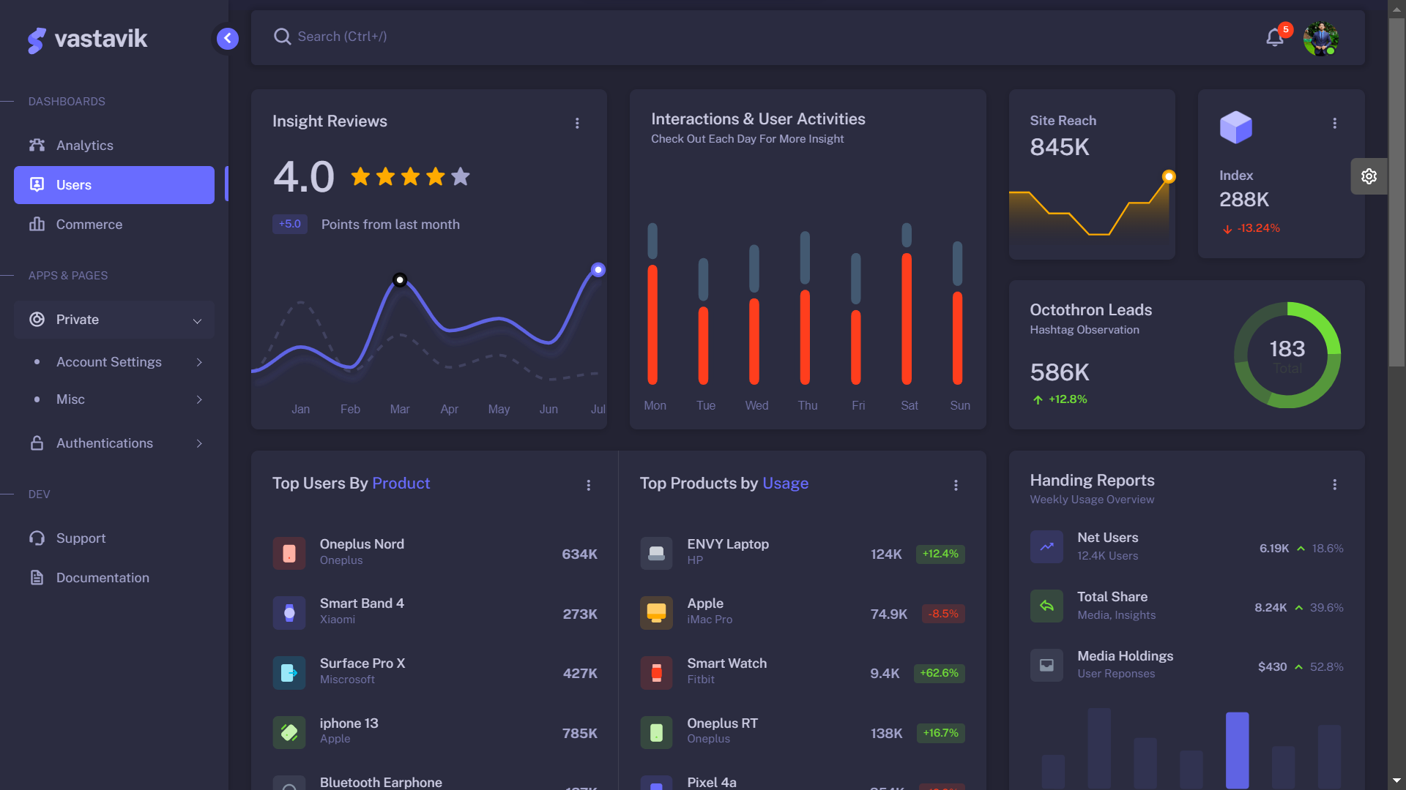
Idea/Approach Details
PROCESS FLOW DIAGRAM
Our Web Application aims to provide detailed insights of social media activities by providing live in sights of engagement created.
Key performance metrics in one place real-time dashboards and wallboards using beautiful and accurate visualizations.
This collected analytics are stored in a database and simultaneously updated in a dashboard which provides Quantitative information by Flask Web Framework.
:
PROTOTYPE:
INPUT
TECH STACK:
OUTPUT

Slide 3


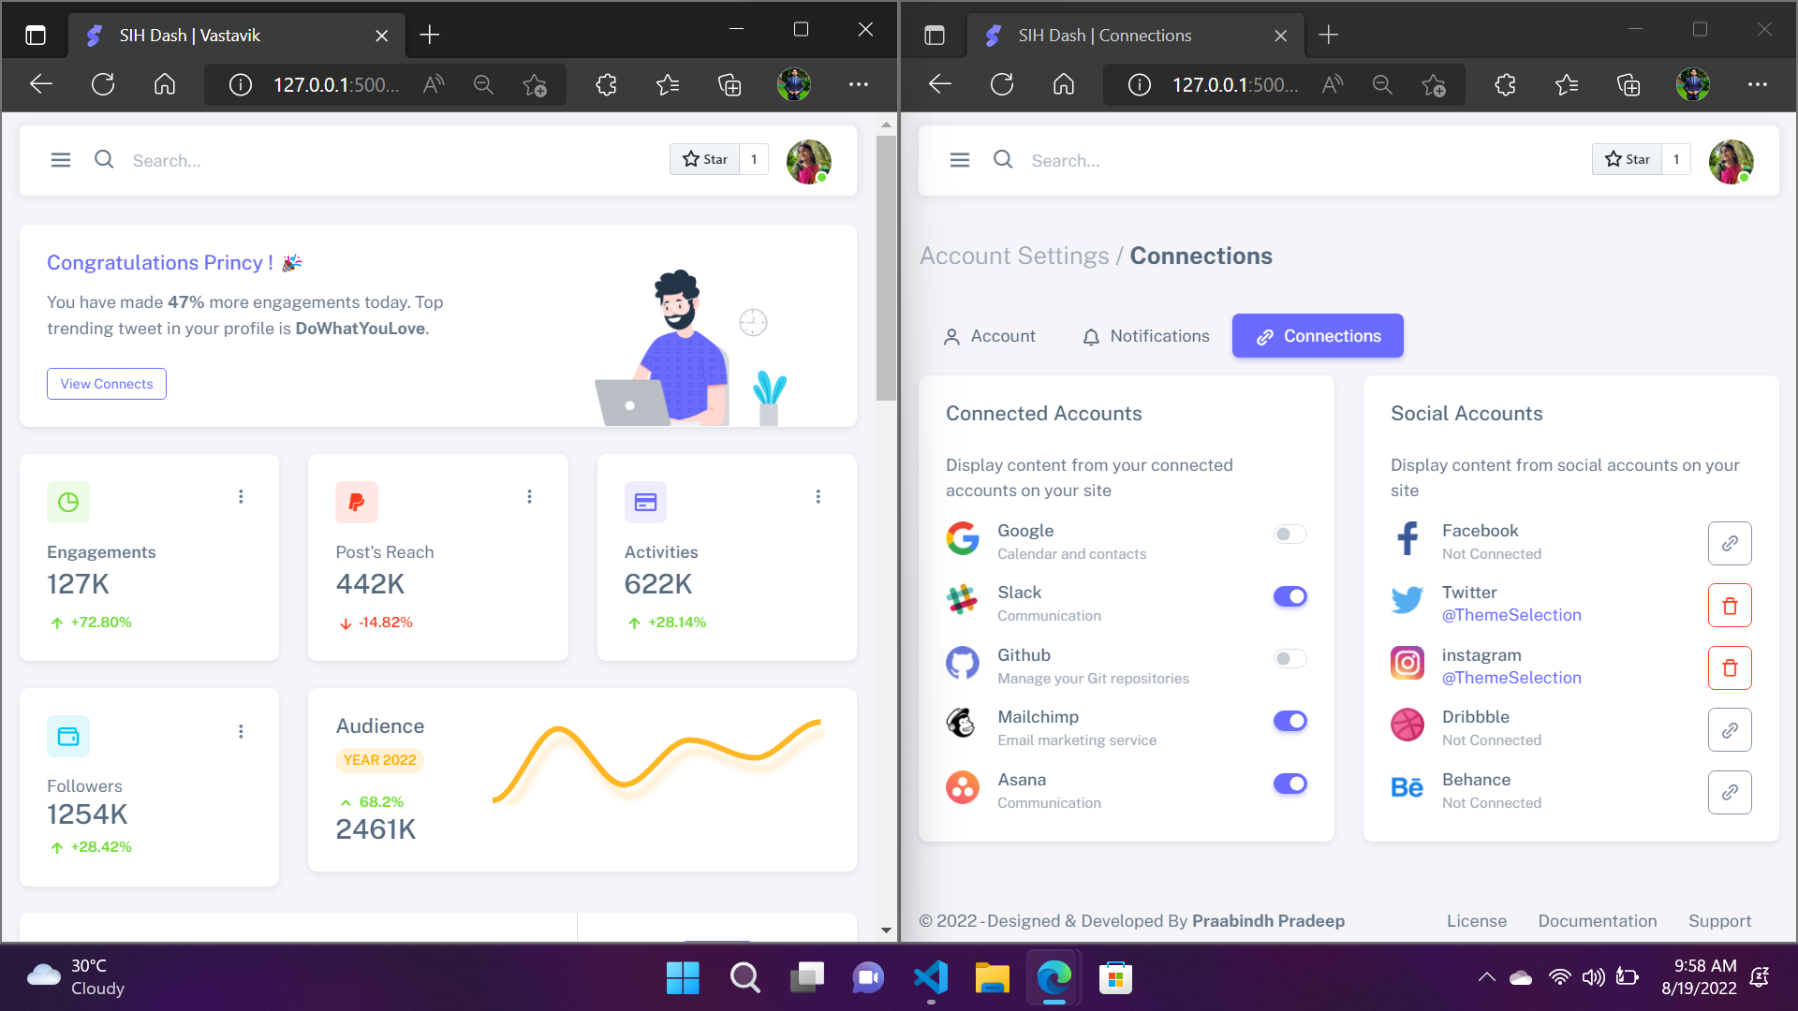
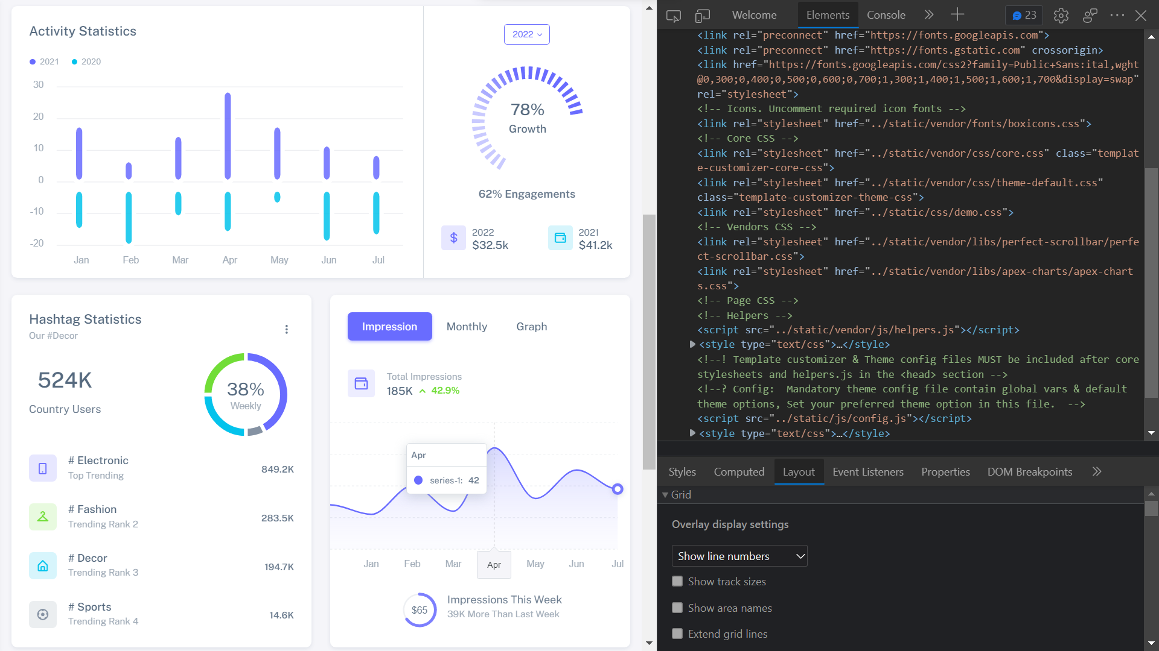
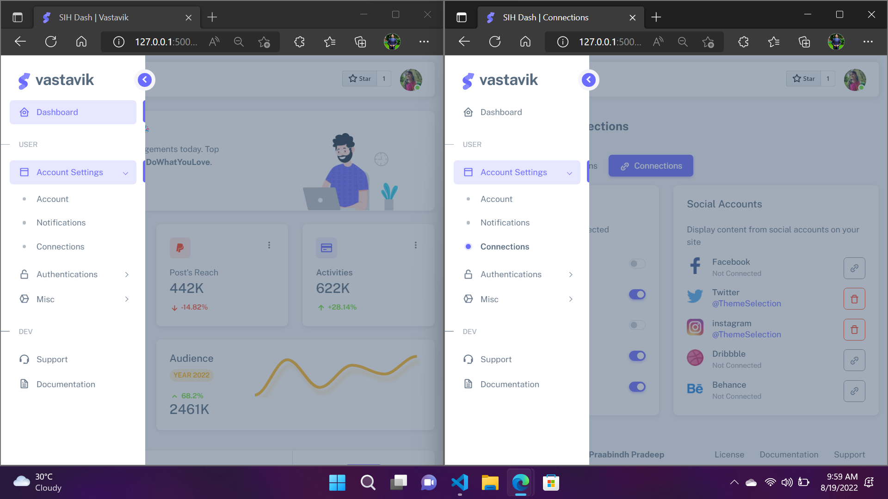
TECH STACK
Javascript
Is an object oriented computer language.
To create dynamic and interactive web content.
To provide functionality to Vastavik.
HTML5
Revision of the Hypertext Markup Language.
It is platform independent.
Creates the contents and appearance of Vastavik.
CSS 3
Iteration of the CSS standards.
Customization of web pages .
Controls Vastavik’s appearance.
Describes the presentation of Vastavik layout.

Slide 4
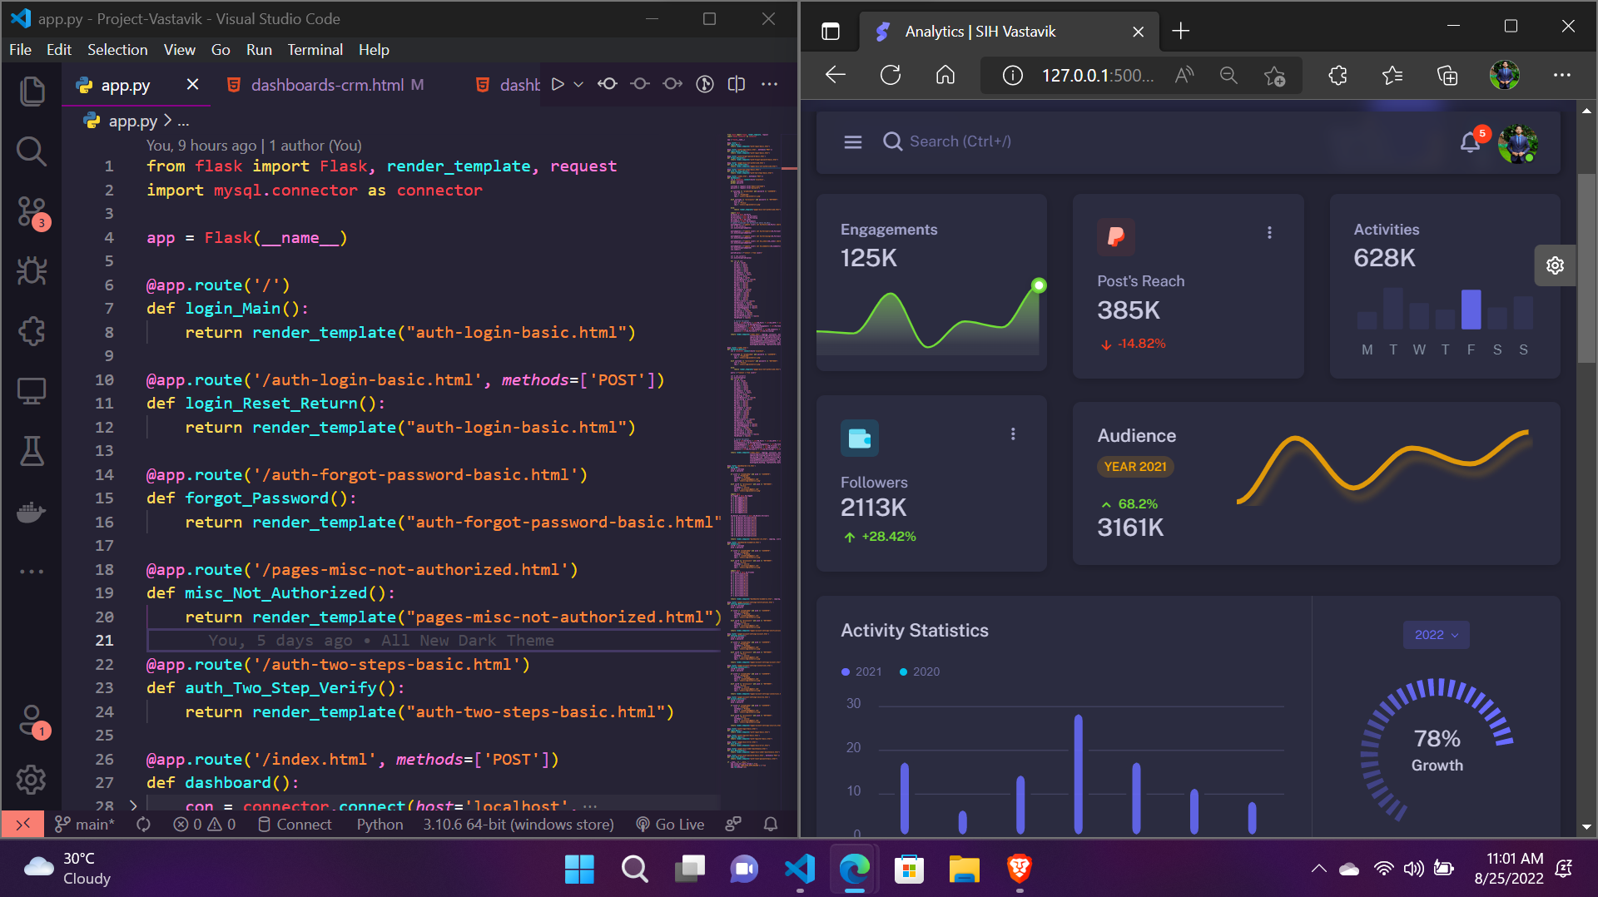
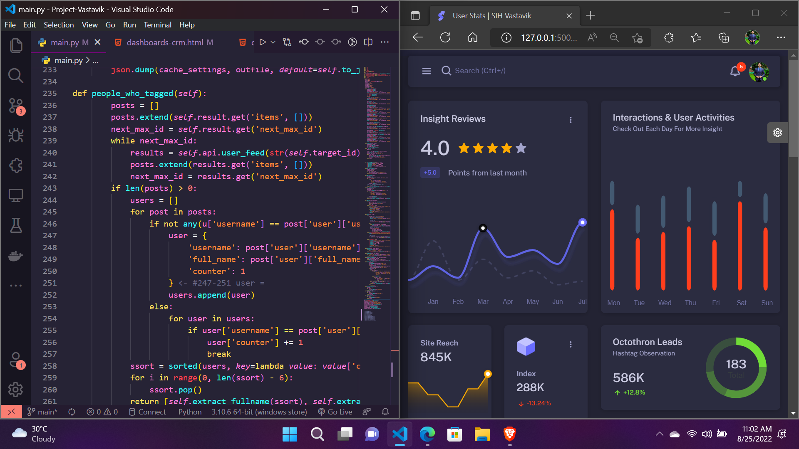
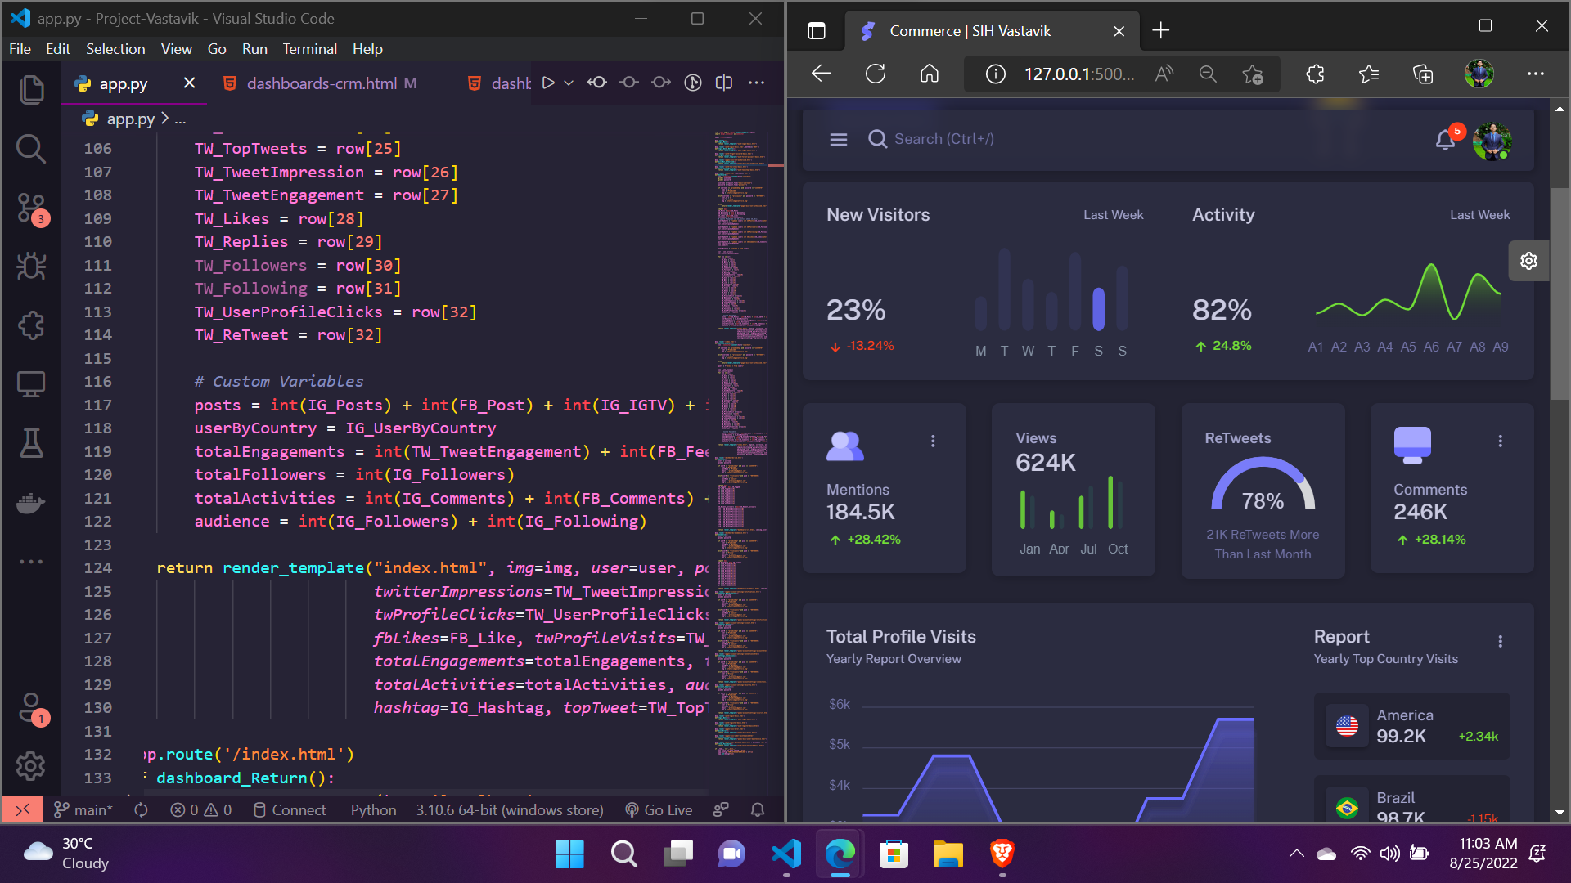
TECH STACK
Flask
Flask is a small and lightweight Python web framework.
Flask comes packaged with the powerful Jinja templating language.
Used for web framework and routing of URL in Vastavik.
Python
Is a high-level, interpreted, general-purpose programming language.
Ability to create and manage data structures quickly.
Used in database connectivity and data processing in Vastavik.
Jinja
Jinja is a web template engine for the Python programming language.
Data passing from Python to HTML.
Complete data parsing is done in the backend of Vastavik.

Slide 5
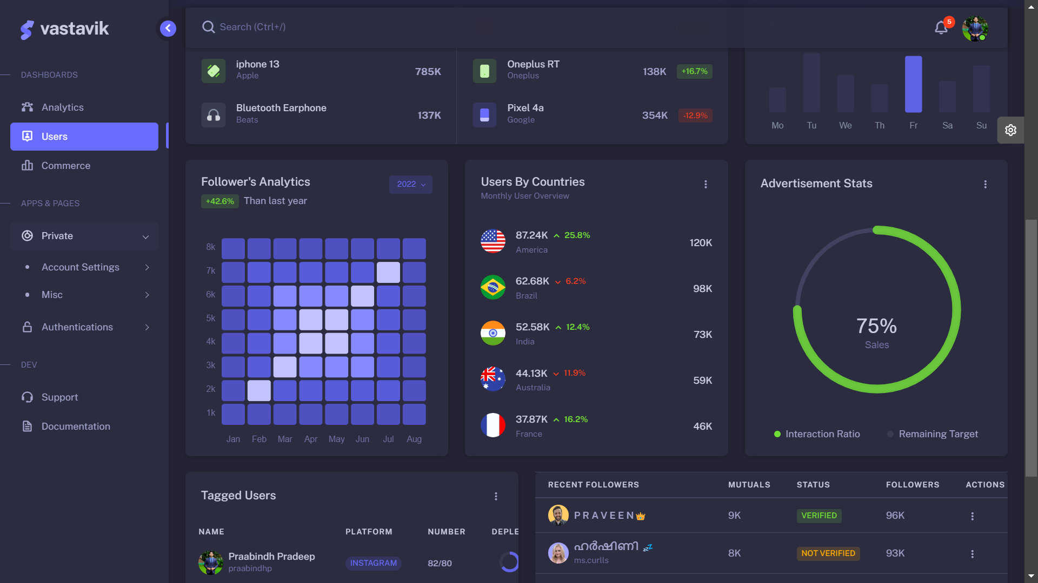
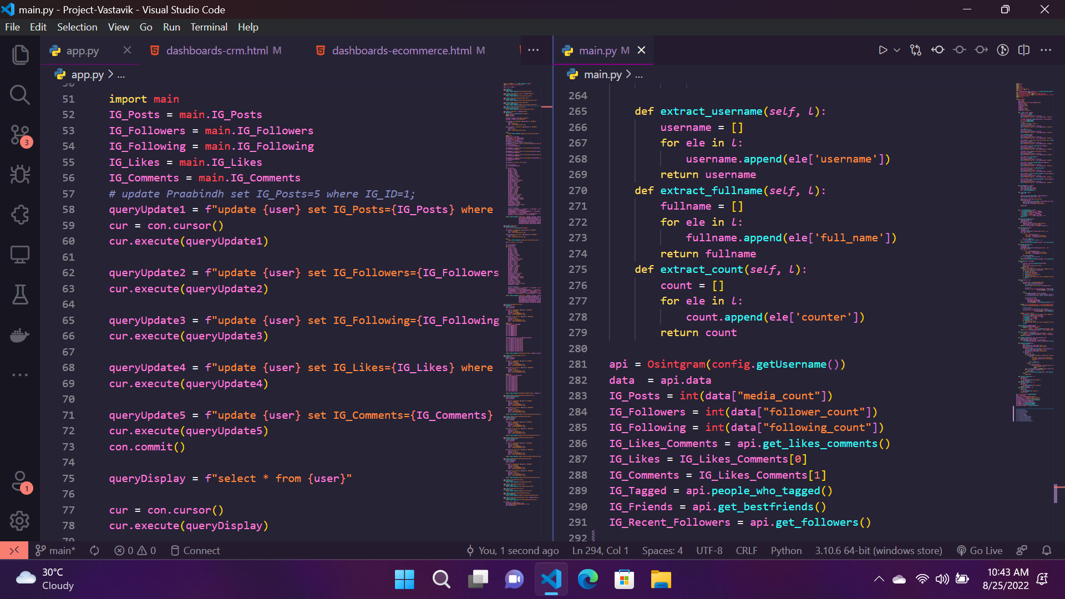
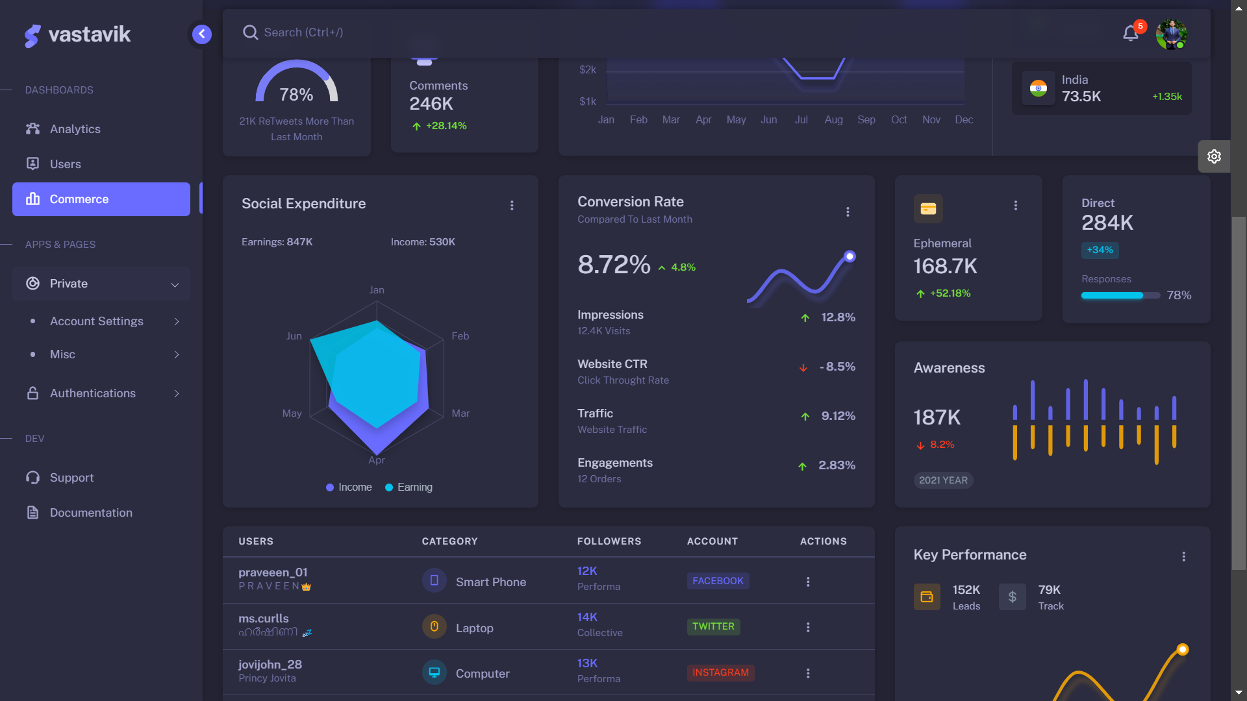
TECH STACK
Plotly
The plotly Python is an interactive, open-source plotting library.
Allows users to improve the visualization experience.
Ideal for building and deploying data apps with customized user interfaces.
Instagram
The instagram API allows users to use app to manage their presence on instagram.
This api is intended for user’s insight into, and full control over all of their social media interactions.
Visualization
Comprehend vast amounts of data
at a glance and in a better way.
Measure its impact on the business and communicates the insight visually to internal and external audiences.

Slide 6
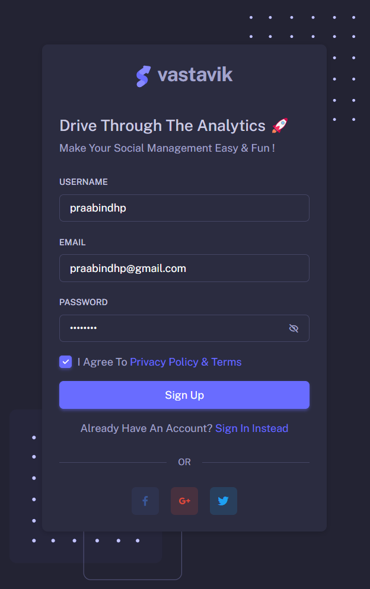
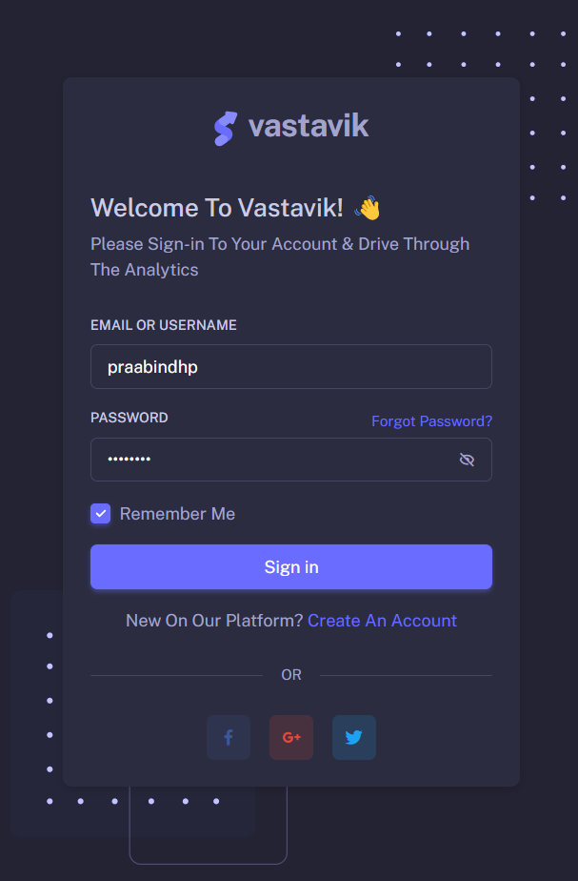
SIGNUP:
LOGIN:
Enables user to independently register and gain access to the dashboard.
Sign up can be done by Google,Facebook and Twitter accounts.
Login is a set of credentials used to gain access to an area required.
An entry to the dashboard that requires user identification and authentication by a username and password combination.

Slide 7
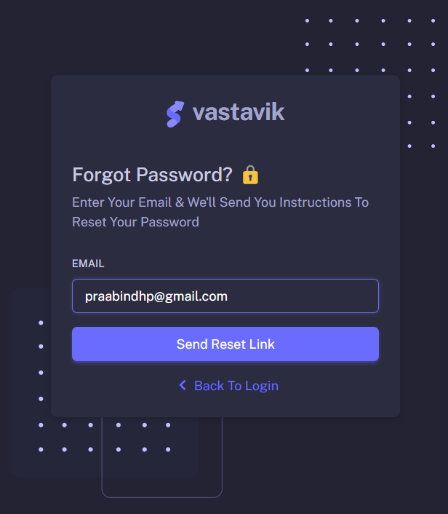
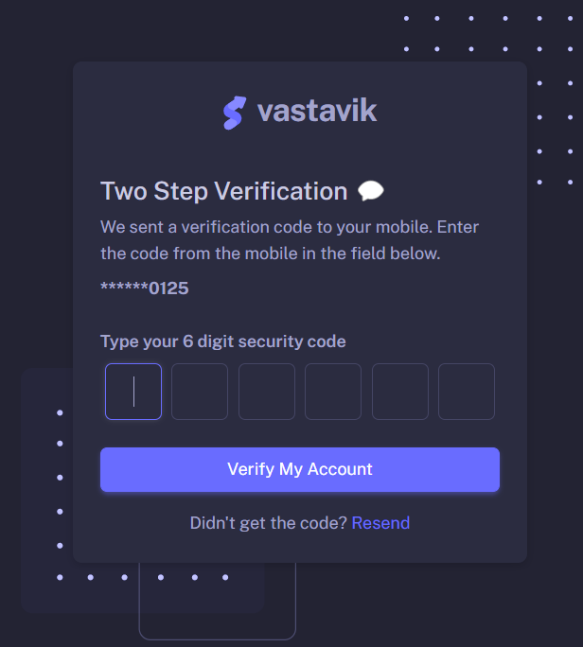
FORGOT PASSWORD:
RESET PASSWORD:
It allows user to unlock,retrieve new passwords for the dashboard if the original password is forgotten.
The user clicks this section and has to reset their account password.
This can be done by answering security questions or email.
The action of invalidating the current password for the dashboard and creating a new password.
This can be done by settings of the dashboard or contacting the administrator.
To Reset your password click the “FORGOT PASSWORD” which mails you the corresponding details for the reset process.

Slide 8
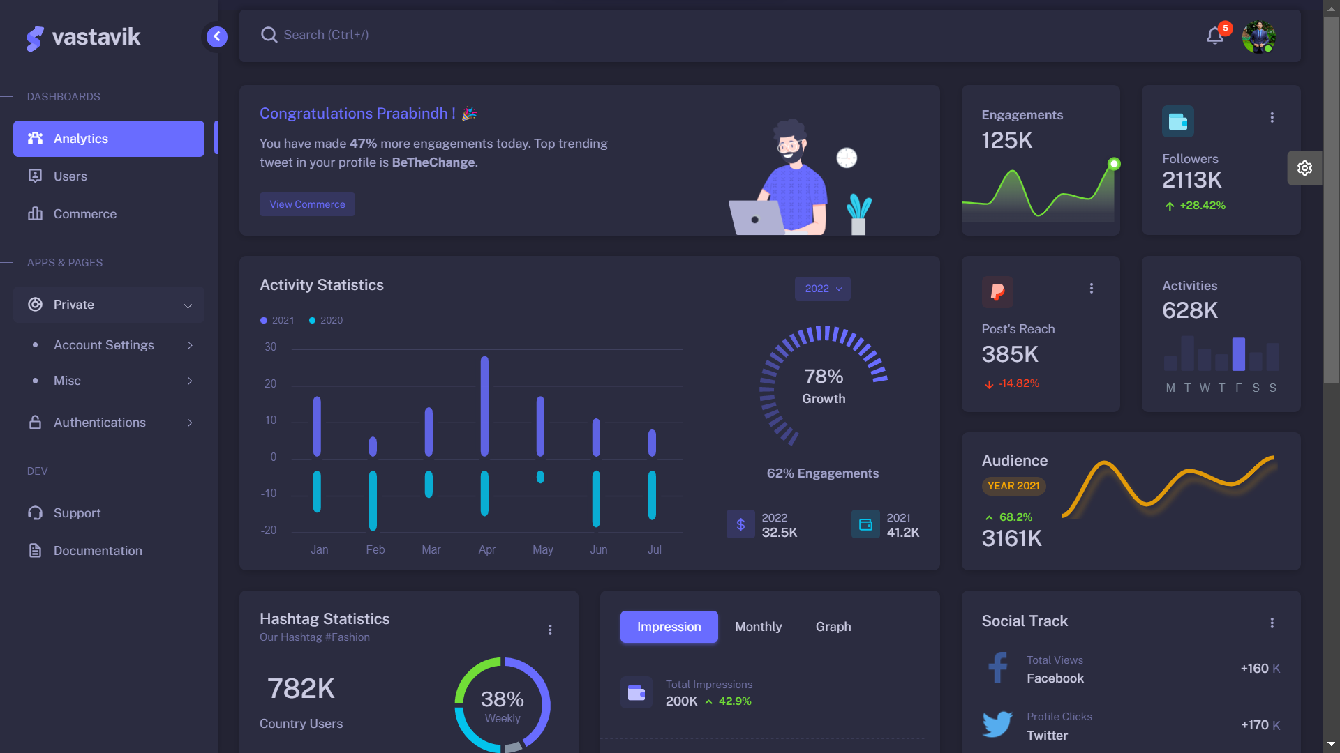
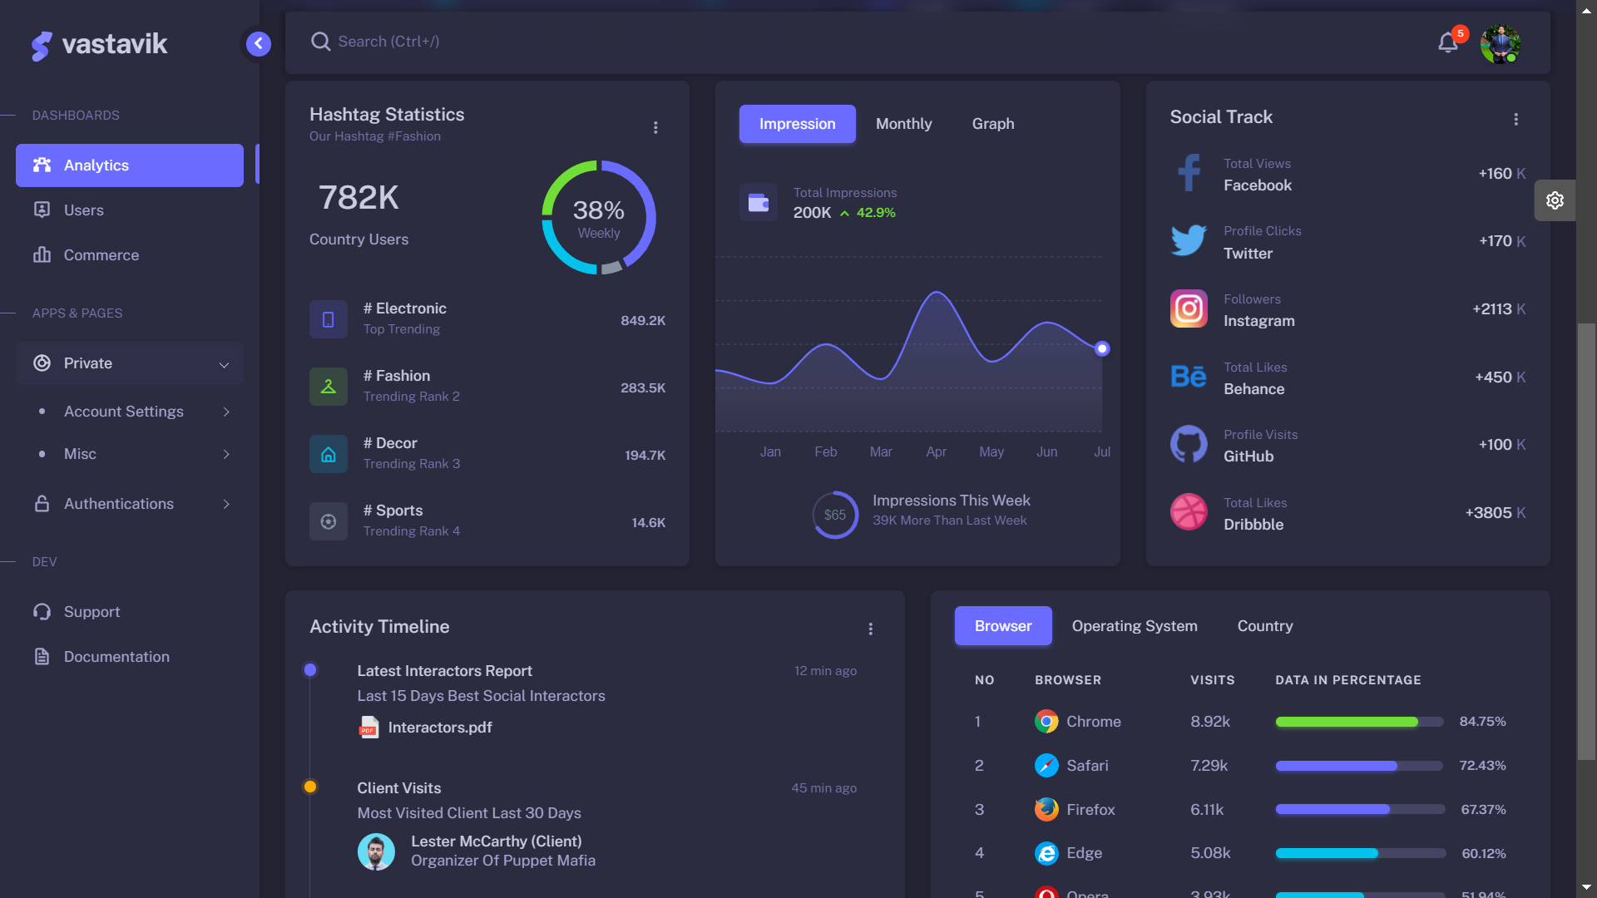
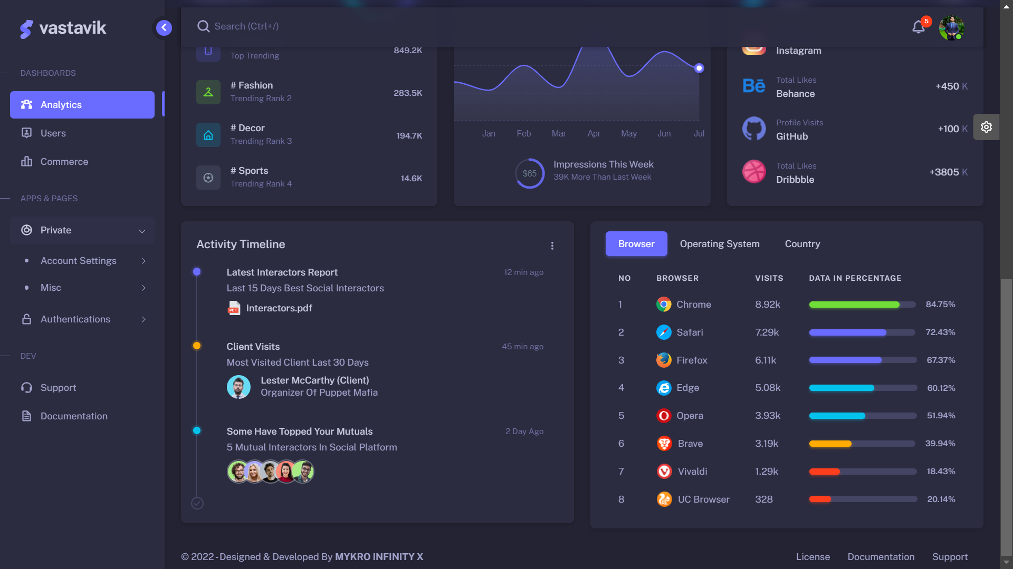
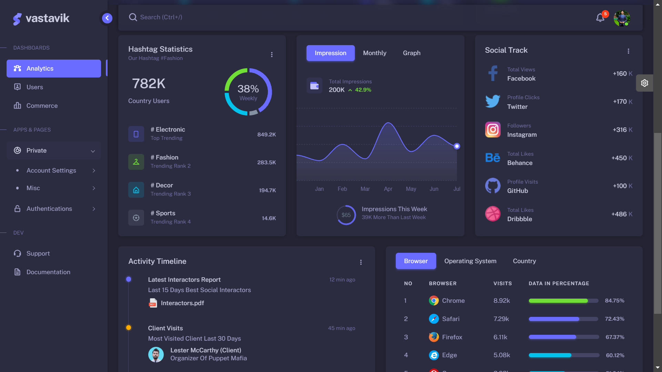
DASHBOARD
ANALYTICS
Our dashboard is a collection of widgets that represents a detailed reports.
Activity statistics depicts the individuals amount of time spent over the various months.
Engagements,Followers,Activities,
Impressions etc from a user’s social media accounts are lively displayed.
Hashtag Statistics gives us the top trending hashtags used all over the world.
Graphical representation of Impressions over various months and list of social tracks are specified.
Bars on user’s most used browser and operating system,user based on countries are well defined.
Growth in the number of audience for the past years has shown.
Total Views and the number of Profile clicks in the social media is calculated and specified.
Impressions for each month is also calculated and specified.

Slide 9
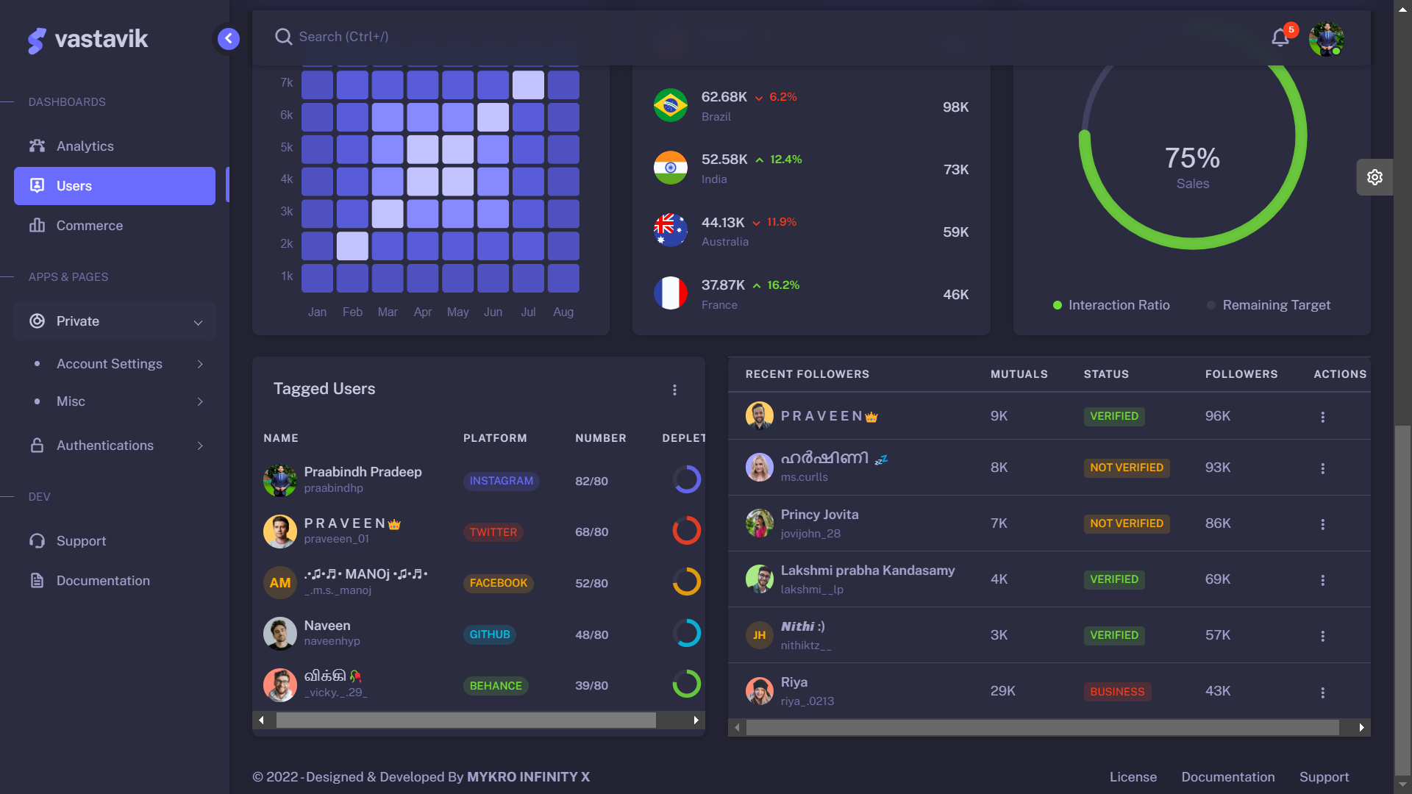
DASHBOARD
USERS
Insight reviews over various months are represented on a scale of 5 stars.
Users are segregated based on products and their usage.
Handling reports section describe weekly usage overview in Bar graphs.
Follower’s Analytics are projected in pictorial representation in comparison with previous year.
User’s are categorized based on countries they live.
List of team members along with their projects,task and progress are defined.
The progress in the Site Reached are shown in the graph.
The count for the usage of the top products by the users are mentioned along with the percentage stating the profit.
The details about the amount whether it is paid or not by the users and the mode of payment is explained.

Slide 10
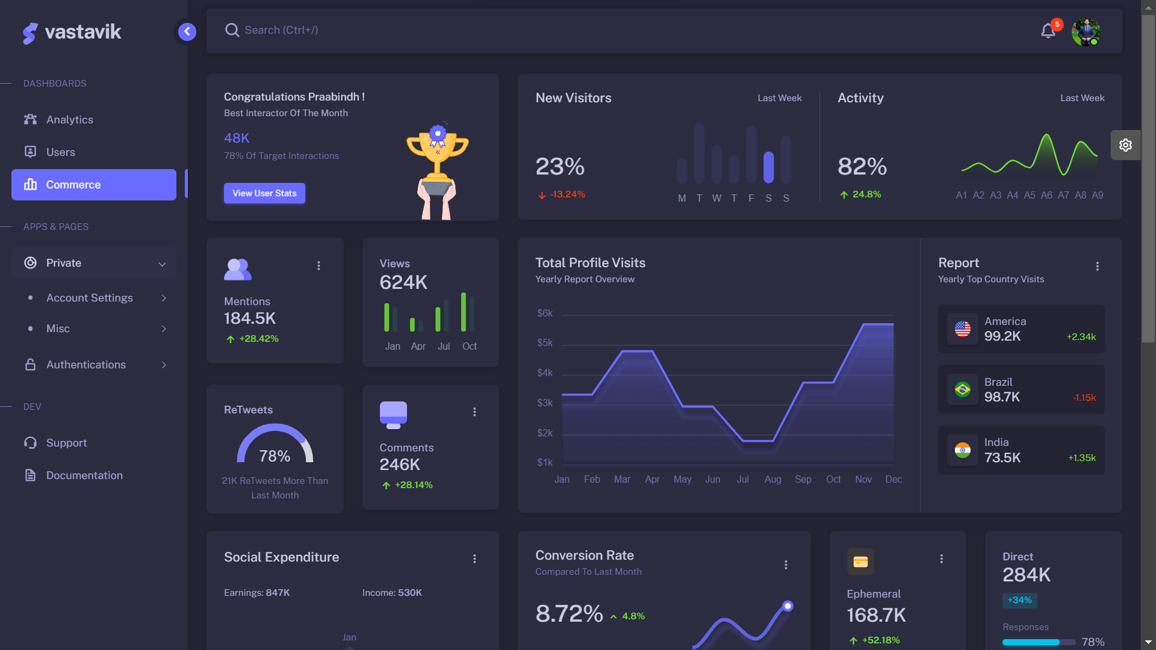
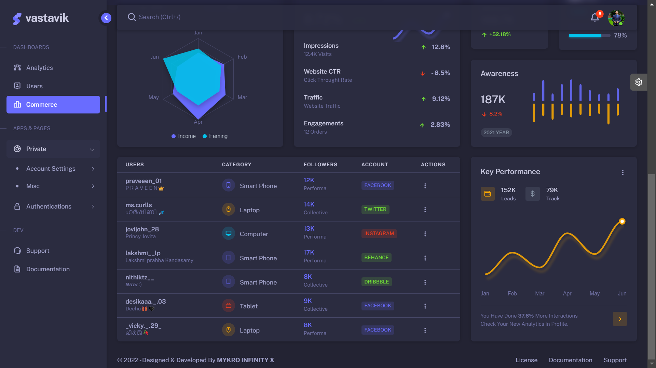
DASHBOARD
COMMERCE
Bar Graphs and line graphs shows the new visitors and the activity status of the profile.
The variations in the Views , Comments and ReTweets and also the count of total profile visits are mentioned in the graph.
Social Expenditure Rate and Conversion Rates are calculated for every month.
The traffic in the market and the outbound of the products due to the pickup and drop off of the products are clearly shown with the curved graph .
The value of Revenue,Sales are calculated with the Conversion Rate.
The Drift in the Expenses for the particular year is calculated and shown in the graph.
Products are sorted based on their model and their types.
The Payment and the order status of these products are calculated.
Details about the value of Wallet and Paypal in the Total campaigns for each month is explained in the graph.

Slide 11
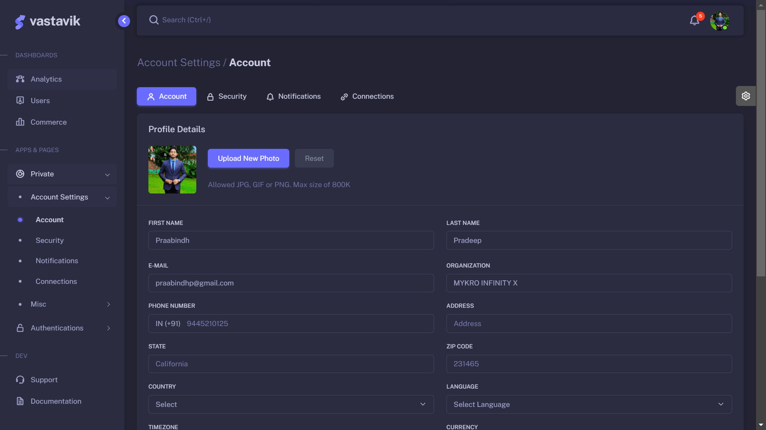
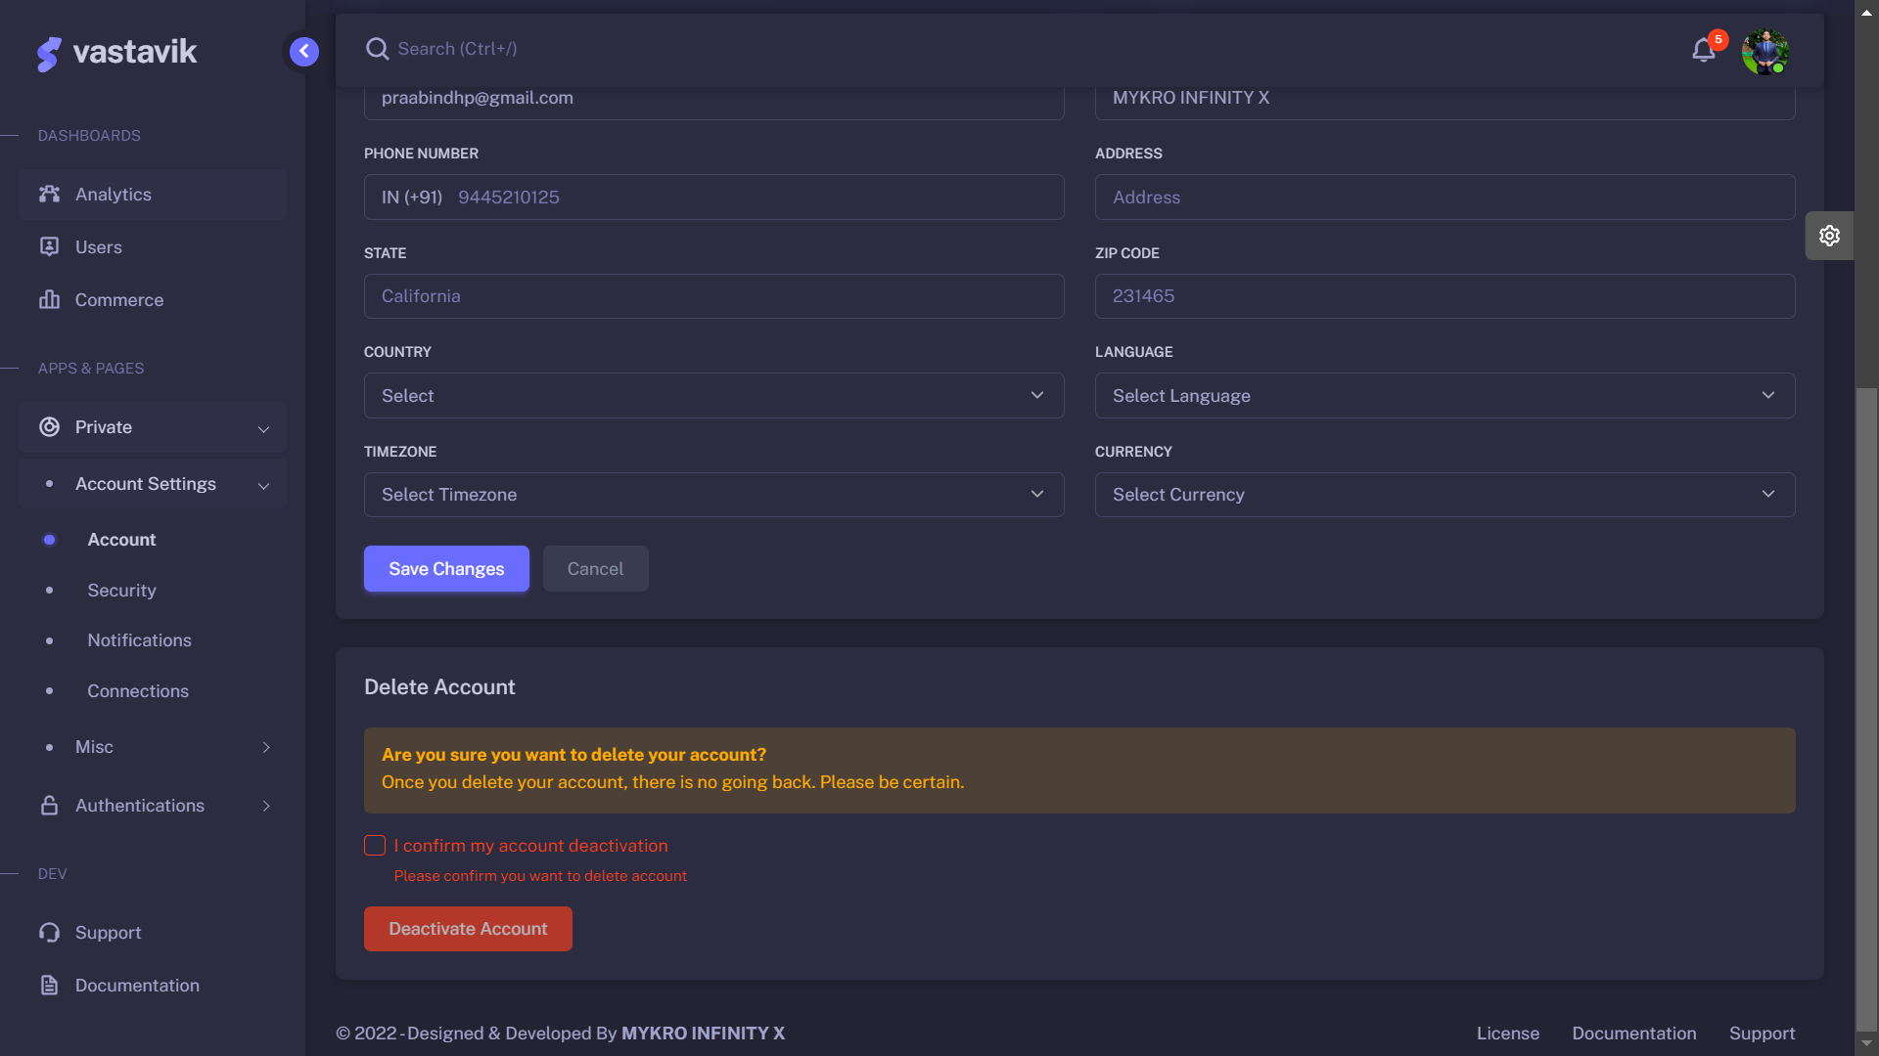
APPS & AUTHENTICATION
SETTINGS : ACCOUNT
Account setting enables the user to set up their own accounts in order to have an access for the sites.
Profile details includes gathering personal information about the user and their photos.
Some notable basic information gathering includes Name,Email,Contact number,Address,Languages etc.
This helps to know more about the user accessing the platform.
Deactivating account is done when a user no longer wishes to use the platform.
Upon deactivating the account the information is prohibited from viewing.
Once the account is deactivated it is no longer live and non searchable.
Deleting an account defines there is no way of getting back or going through it again.

Slide 12
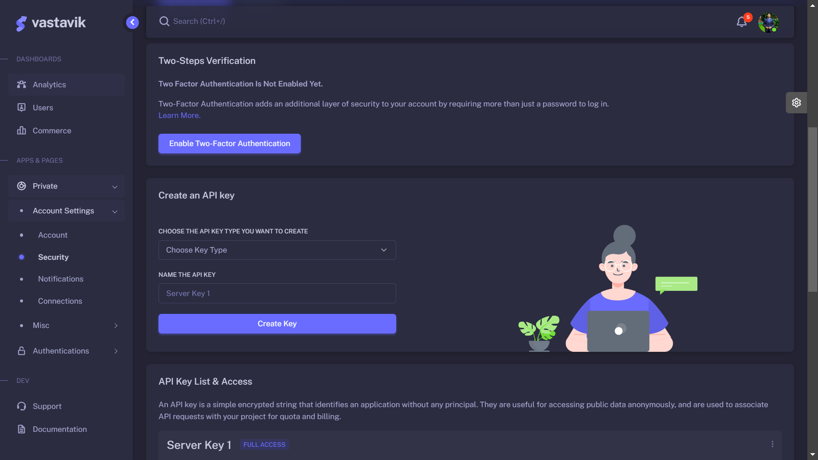
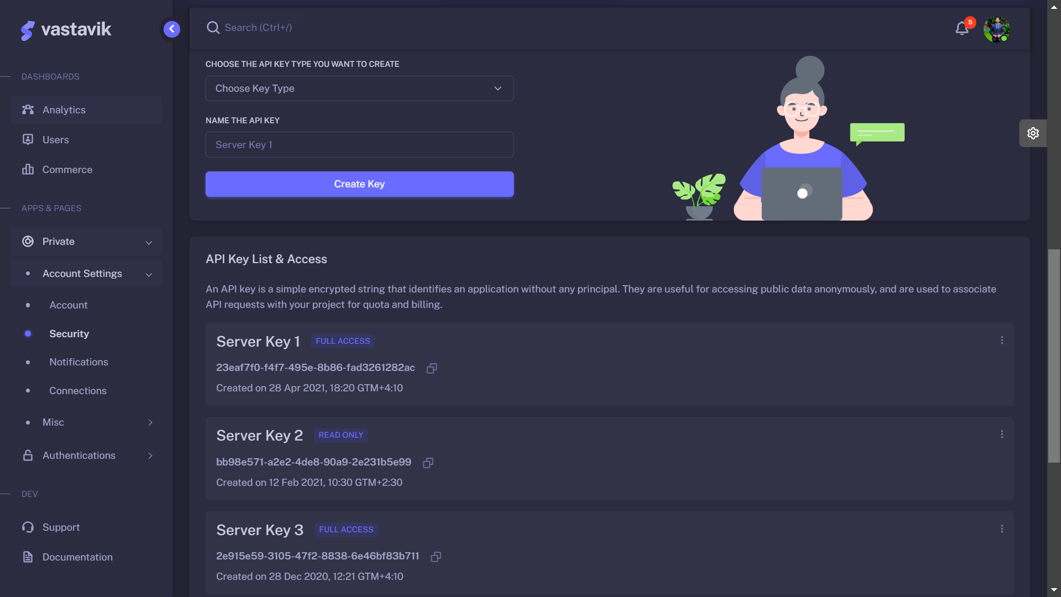
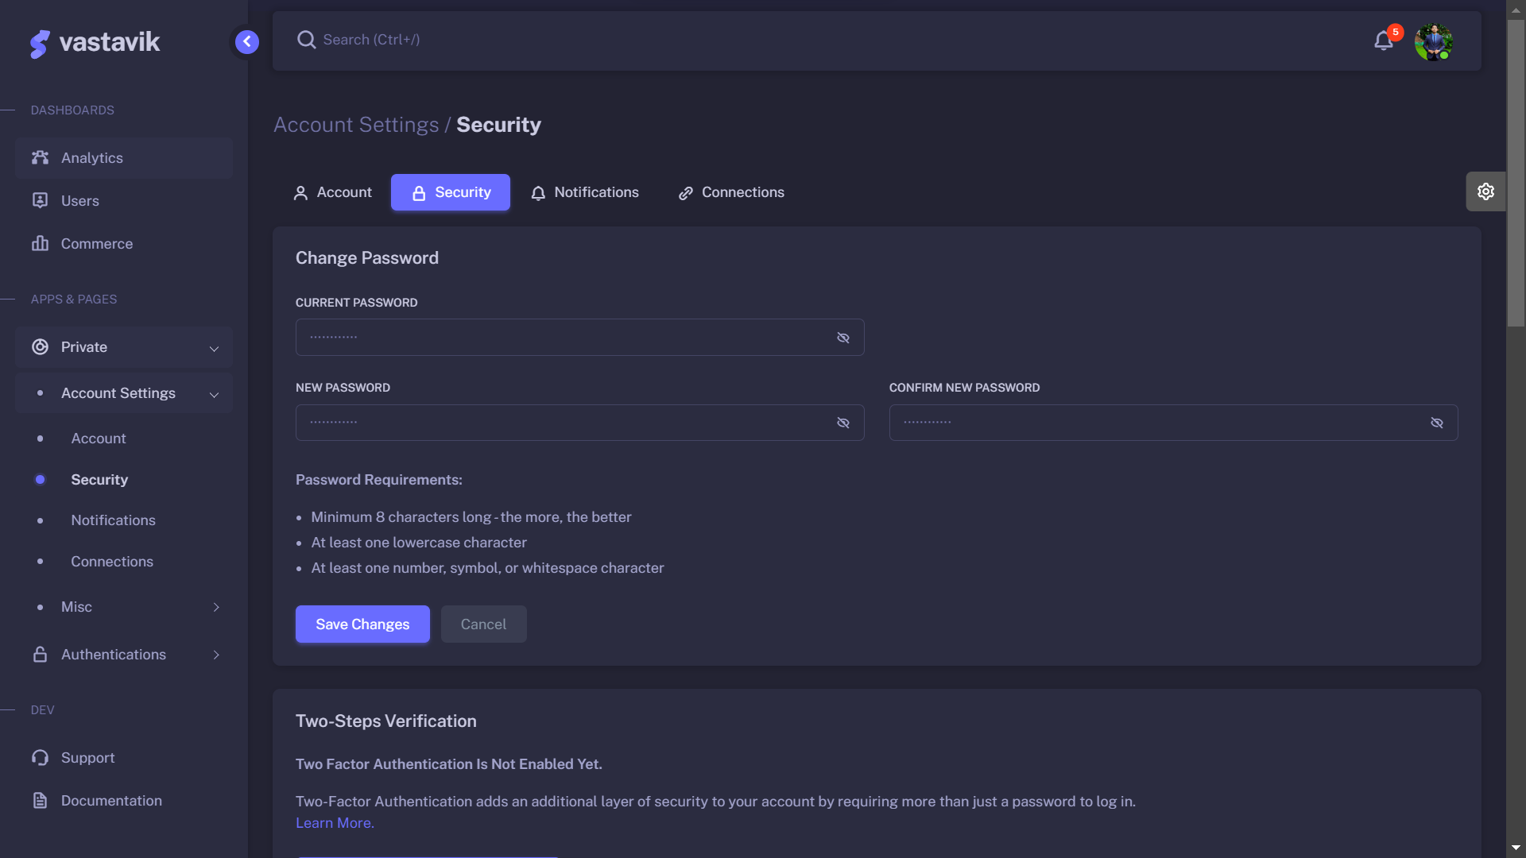
APPS & AUTHENTICATION
SETTINGS : SECURITY
The features to change the password and the password requirements are mentioned.
To provide more security to the users, Two step verification process is also enabled.
Creation of API Keys is provided.
List of API Keys are mentioned.
The activities about the various devices and their locations and the browser being used in these devices are found and noted.

Slide 13
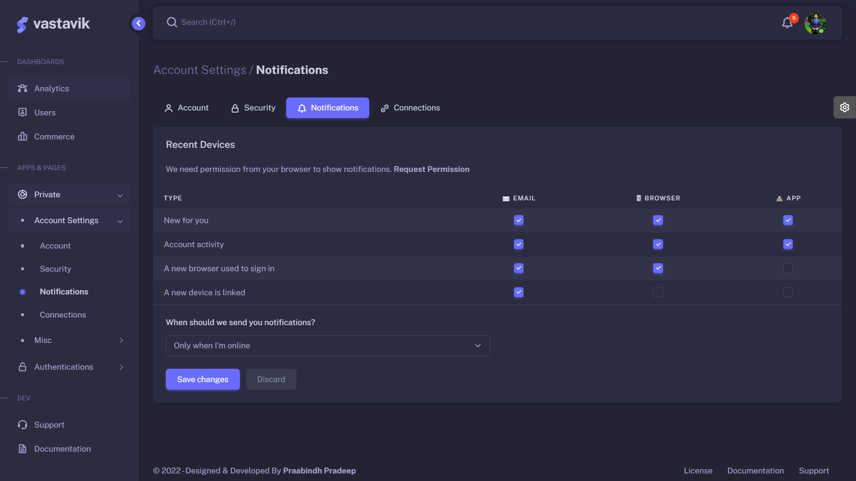
APPS & AUTHENTICATION
SETTINGS : NOTIFICATIONS
The act or an instance of giving notice or information.
A message that is been displayed in the UI to provide the user with remainders and permission is asked when there is a remainder that is to be displayed.
Once the permission is granted , Notifications are sent.
Notifications can be sent via emails or sms and the content of notification can also be defined by the user.
Receiving notification can be time based and modified according to user’s wish.
.

Slide 14
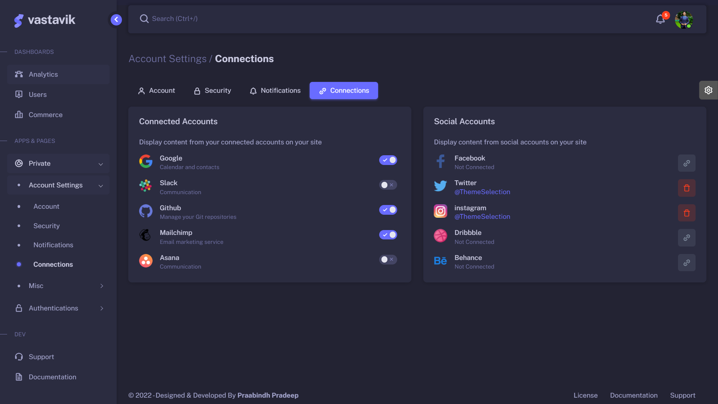
APPS & AUTHENTICATION
SETTINGS : CONNECTIONS
Connections are established between the user and different platforms to have an ease of access.
List of connected accounts and social accounts of a user are specified along with its state either it is active or inactive.
Connected accounts include gathering information from the accounts and displaying them when needed.
Connected accounts include: Google,Slack,GitHub,
Mailchimp,Asana etc.
Social accounts that are currently connected are also listed.
Top social media accounts include
Facebook,Twitter,Instagram,Dribble,Behance etc.

Slide 15
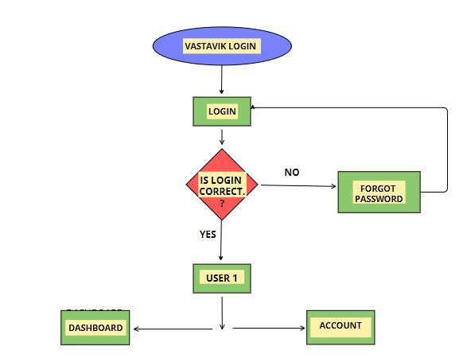
APPS & AUTHENTICATION
SETTINGS : CONNECTIONS
VASTAVIK LOGIN has enabled the features to provide the Username and Password to login into the VASTAVIK WEB APP.
The Process is validated based on the details given,if true it gets into the VASTAVIK WEB APP else Forget password procedure is done.Multiple Users can be logged in with their registered username and password.
Dashboard for these multiple user explaining about their social media profile and the profile’s analytical growth , progress about the various browser and operating system have been clearly implemented.
Two factor Authentication, security features and the connections are also implemented.

Slide 16
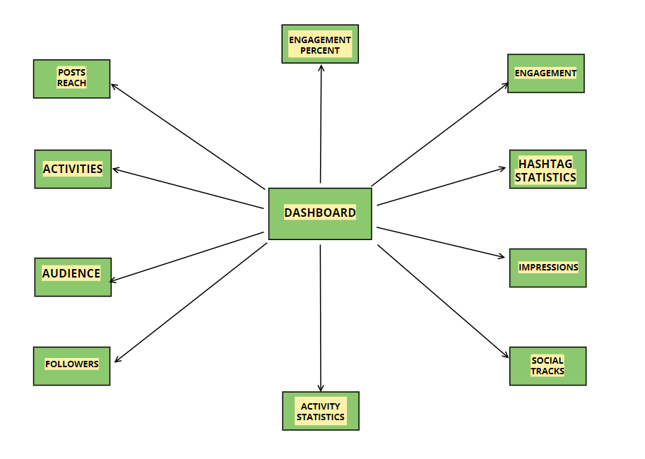
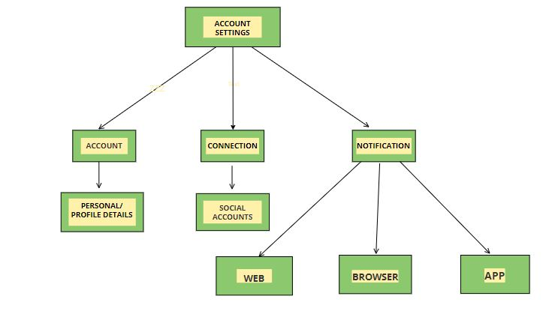
PROCESS FLOW
Our Dashboard contains a feature named Account Settings where the details about
the Accounts,Connections and Notifications are specified.
Accounts contains personal details about the user and Connection handles the
social accounts of the user.
Notification is a note of information that is been displayed to the user by Web,App and Browsers.
VASTAVIK dashboard has been designed and implemented in such a way that we display the activities, audience ,followers, activity statistics, social tracks, impressions, hashtag statistics, engagement, engagement percent and the post reach can be viewed.
-

Slide 17
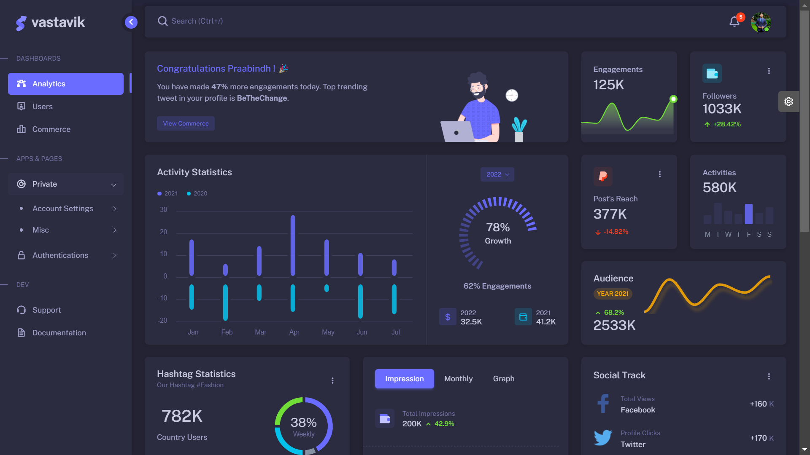
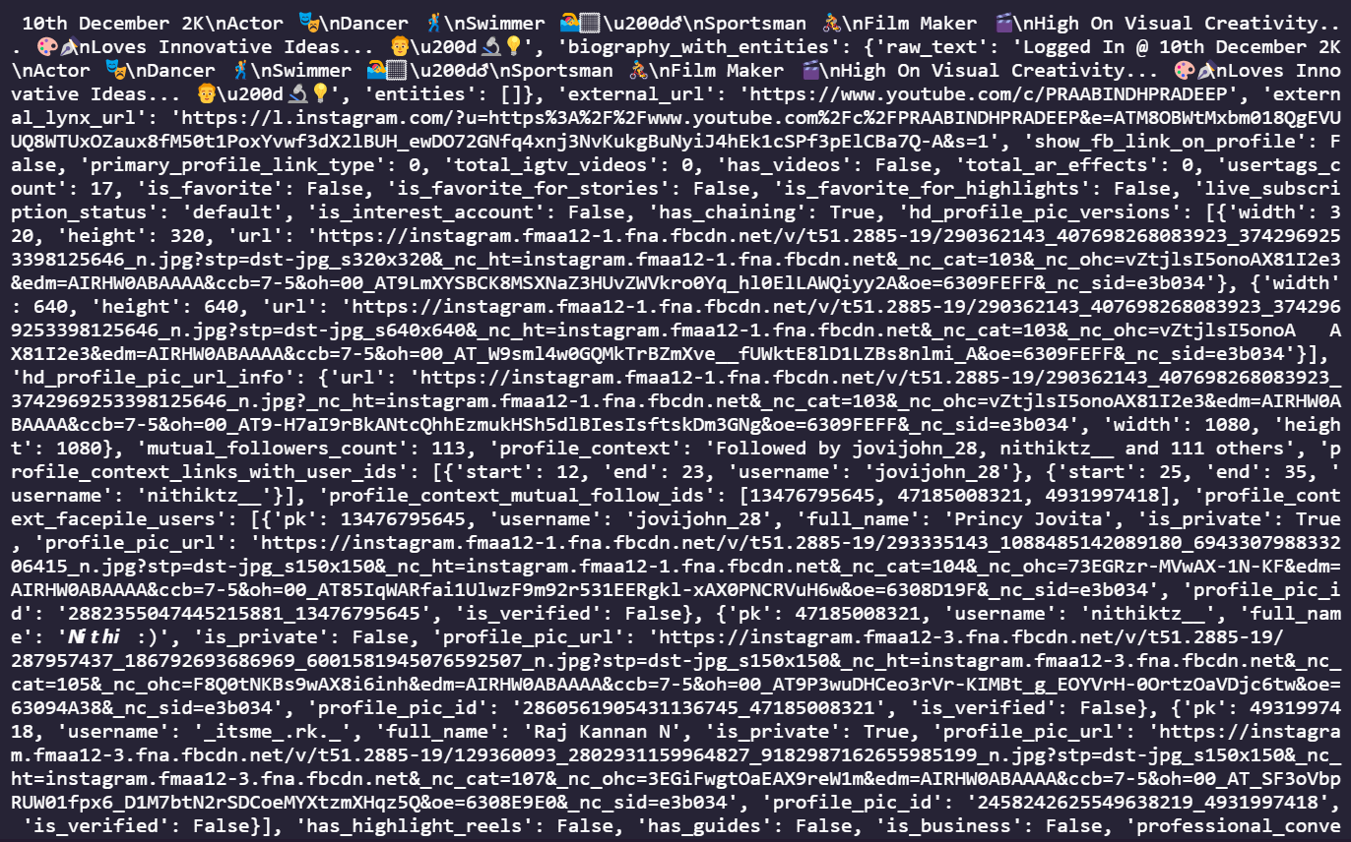
Systematic Data Clean Processing
Data cleaning is the process of fixing or removing incorrect, corrupted, incorrectly formatted, duplicate, or incomplete data within a dataset. When combining multiple data sources, there are many opportunities for data to be duplicated or mislabeled and Extraction of raw data using API and processing them to display them in better way.

Slide 18
Team Member Details
Team Leader Name
Branch : B.Tech
Team Member 1 Name
Branch : B.Tech
: PRAABINDH P
Stream : IT
Year : IV
: PRINCY JOVITA J
Stream : IT
Year : IV
Team Member 2 Name
Branch : B.Tech
Team Member 3 Name
Branch : B.Tech
: PRAVEEN V
Stream : IT
Year : IV
: PAVITHRAMUKI R
Stream : IT
Year : IV
Team Member 4 Name
: NITHISH M
Stream : IT
Year : IV
Branch : B.Tech
Team Member 5 Name : NIVETHA N
Branch : B.Tech
Team Mentor Name : DR. LOGESHWARI D
Category(Academic/Industry): Academic
Stream : IT
Year : IV
Expertise:ML
Domain Experience(in years): 10

